Slide 1

HEALTHCARE DATA ANALYSIS
Presented by:
Power BI Team
David B., Onyinye O., Judith C., Michael O., Amidat M., Comfort D., Omoniyi F., Philip C.

Slide 2

Table of Content
Introduction
Objective & Business Question
Data transformation & cleaning
Data Modelling
Dashboard Overview
Analysis and visualization
Recommendation
Conclusion

Slide 3
Introduction
This is a Power BI project that explores a comprehensive healthcare dataset to uncover insights into patient demographics, medical trends, hospital operations, insurance coverage, and billing patterns.
The dataset includes key attributes such as patient age, gender, blood type, medical condition, admission and discharge details, hospital and doctor information, billing amount, insurance provider, and test results.
This analysis supports healthcare providers and administrators in identifying critical trends and making data-driven decisions to enhance patient outcomes and optimize healthcare delivery.

Slide 4
Objective To identify how demographic, medical, and operational factors such as age, gender, blood type, medical conditions, admission types, and insurance coverage, affect patient care, treatment outcomes, and hospital costs in order to support better decision-making in the healthcare system.
Business Questions
Understand Patient Demographics
What is the average age of patients?
What is the gender distribution (male vs. female)?
Which blood type is most common?
Hospital & Doctor Performance
Which hospitals have treated the most patients?
Which doctors handle the highest number of cases?
What is the average billing amount by hospital and doctor?
Insurance & Billing Patterns
Which insurance provider covers the most patients?
Which admission type has the highest billing average?
How do test results affect billing amounts (Normal vs Abnormal)?
Time-Based Analysis
Which month has the highest number of admissions?
What is the average length of stay (Discharge – Admission)?
Is there a correlation between length of stay and billing amount?
Analyze Medical Trends
What are the top medical conditions among patients?
Which medications are most commonly prescribed per condition?
How are patients admitted: Urgent, Emergency, or Elective?
Do certain medical conditions relate to abnormal test results?
Storytelling & Insights
What type of patients are most commonly admitted?
Which hospitals or doctors handle more critical cases?
What are potential opportunities to reduce costs or improve care?

Slide 5
Data transformation & cleaning
Missing Values: No missing values found in the dataset
Duplicate Records
Removed 534 duplicate rows
Dataset reduced from 55,501 to 54,966 rows
Inconsistent Data Formats
Fixed formatting issues in Name and Billing Amount columns
Data Type Conversion
Converted date columns to proper date type
Changed Billing Amount to currency format

Slide 6
Data Modelling
• Wrote useful DAX Measures (e.g., Total Admissions, Length of Stay).
• Used slicers and visuals to validate that filters and relationships worked accurately.

Slide 7
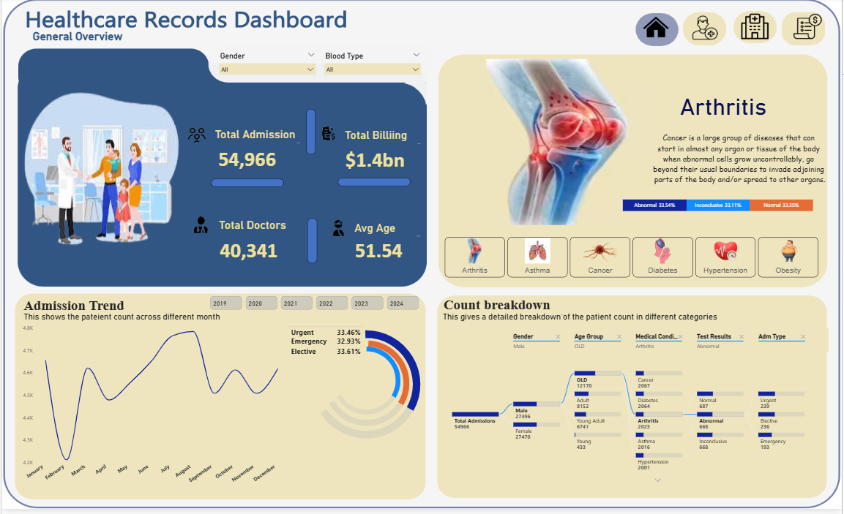
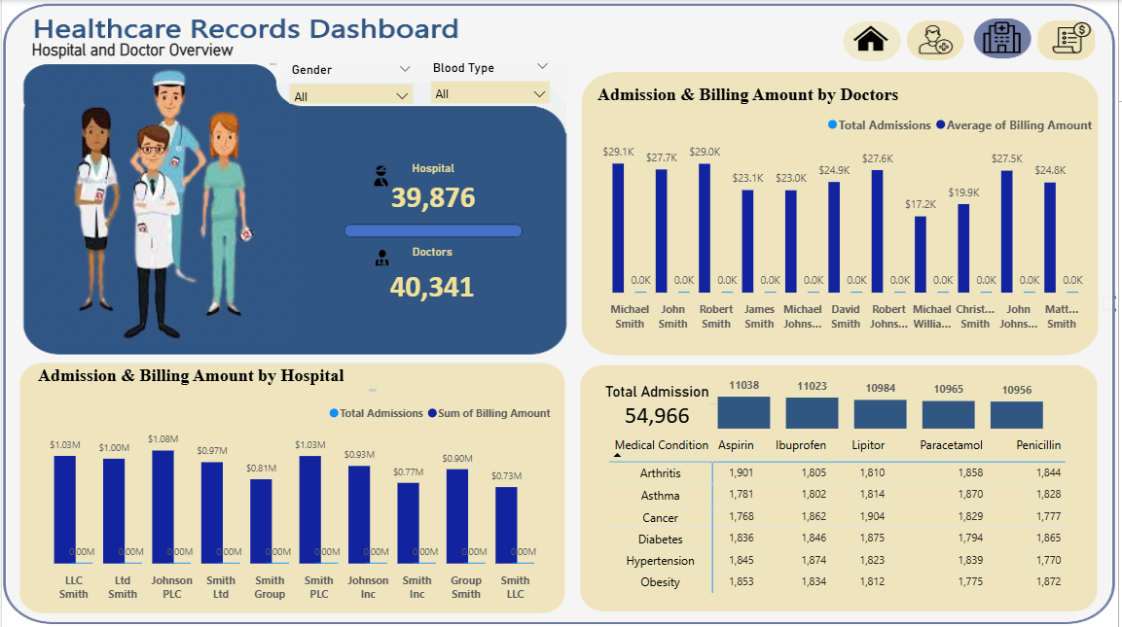
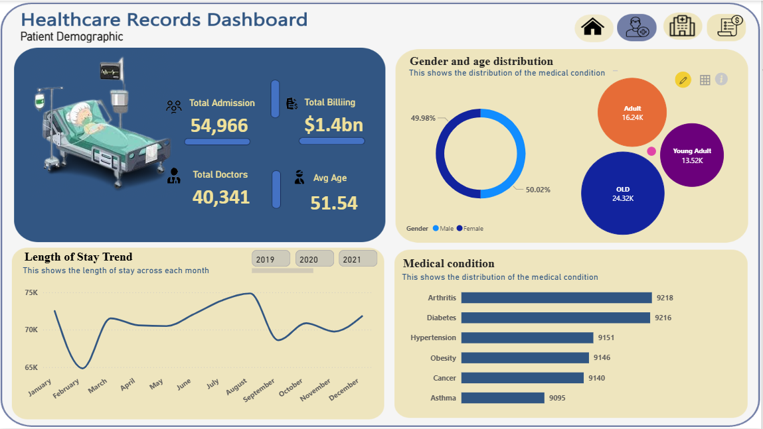
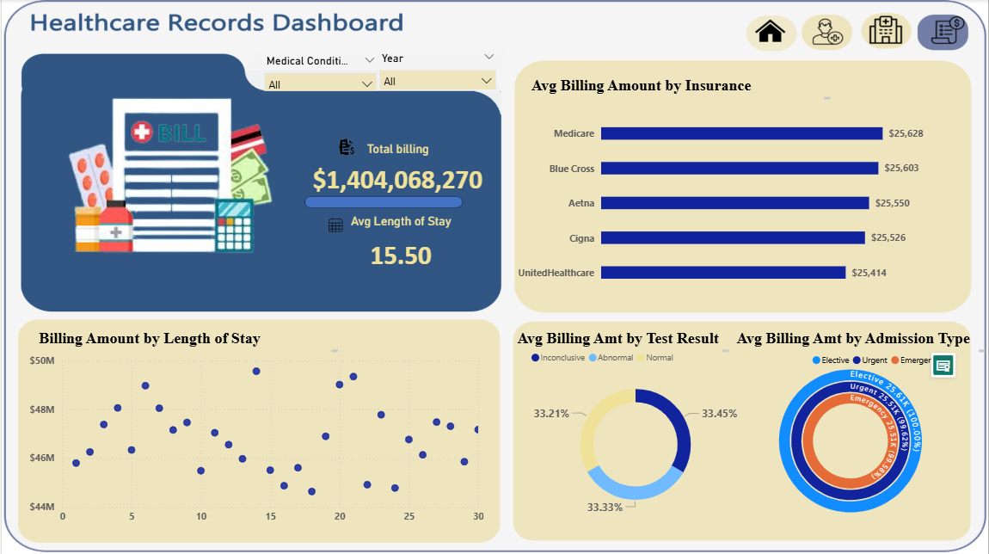
Dashboard Overview
Four pages representation of the health care dataset, namely : The general overview, patient demographics, Hospital and doctors overview, Billing and insurance overview
The general overview contains general information on the dataset like :total patient, breakdown of the medical conditions, age and the billing amount.
Hospital and doctors overview provides more insight on the hospitals used and doctors .
Patient demographics provides more insight on age breakdown, gender and medical condition of the patient.
The insurance and billing page provides insights on the money spent on how various factors such as hospital, doctor and length of stay affect the billing.

Slide 8
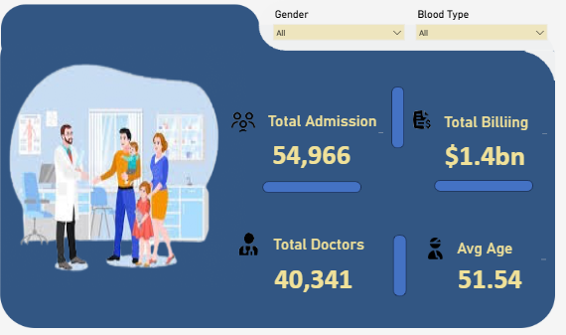
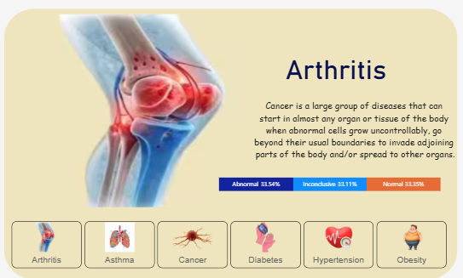
Analysis and visualization
This chart shows the key metrics
Total Admission: 56,966 patients have been admitted.
Total Billing: The total healthcare billing is $1.4 billion.
Total Doctor: There are 40,341 doctors
Average Age: The average age of patients is 51.54 years.
This shows the different Medical condition : which include arthritis asthma, cancer, diabetes, hypertension, and obesity with its definitions.
It also shows percentage of test result distributions for each medical condition: Abnormal, Inconclusive, Normal.

Slide 9
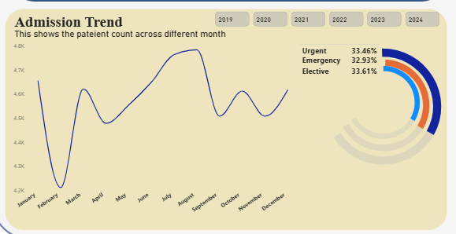
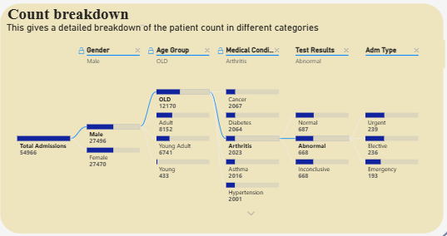
Analysis and visualization
This shows the Admission Trend which has two charts: Line chat and donut chart
This line graph visualizes monthly patients admissions.
. There is a noticeable increase in admissions around July and August, peaking near 4.8k admissions.
. A slight dip is observed in February and October.
The donut chart It also shows percentage of Admission type urgent, emergency and elective.
This distribution tree diagram shows patients count breakdown across.
Gender, Age Groups, Medical Condition, Test Result, Admission Type.
For instance the Male Patients were 27,466 total; the Old age group has the highest count (12,170). Arthritis Cases: in males are 2,063. Among Arthritis patients, 687 had normal results, while 668 had abnormal results. The majority of arthritis patients with abnormal results were admitted through urgent routes (239 patients).

Slide 10
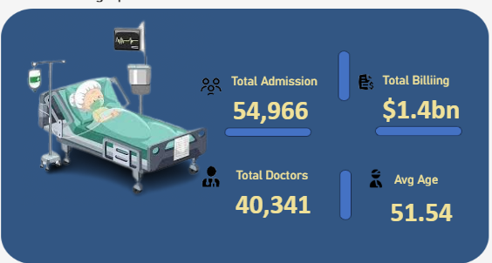
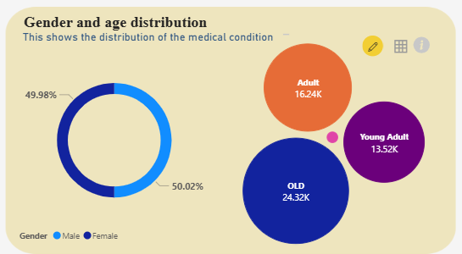
Analysis and visualization
This shows the major Key metrics
Total Admission: 54,966
Total Billing: $1.4 billion
Total Doctors: 40,341
Average Age: 51.54 years
This image contains two charts first is the donut chart showing Gender distribution of the patient Female:49.98% while the Male:50.02%
The bubble chart showing the Age Group Distribution
. Old: 24.32k
. Adult: 16.24k
. Young Adult: 13.52k
The older age group makes up the largest share of patients, which means that healthcare needs rise with age.

Slide 11
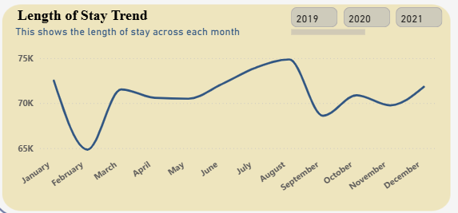
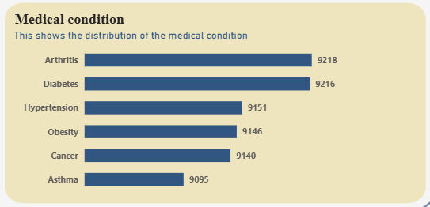
Analysis and visualization
Shows monthly trends in patients length of hospital stay.
. Highest length of stay observed in August (75k).
. Lowest observed in February (65k).
. There are visible dips and rises, but the trend remains within a 65k-75k range
The bar chart shows the Medical Condition distribution of the patients
Top conditions by patients count:
. Diabetes: 9,216 being the highest while
. Arthritis: 9,218
. Hypertension: 9,151
. Obesity: 9,146
. Cancer: 9,140
. Asthma: 9,095

Slide 12
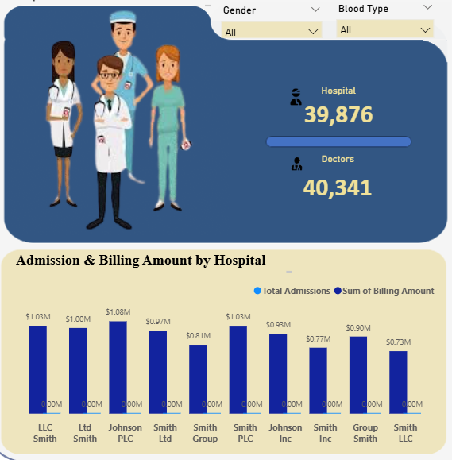
Analysis and visualization
This show the key metric for hospital and doctors overview.
Hospitals covered: 39,876
Doctors: 40,341
The bar charts shows top 10 hospitals by Total Admission (light blue) and Billing Amount (dark blue)
Top Billing Hospitals:
. Smith Ltd -$1.08m
. LLC Smith -$1.03m
. Smith Group -$1.03m
. Johnson PLC -$0.93m

Slide 13
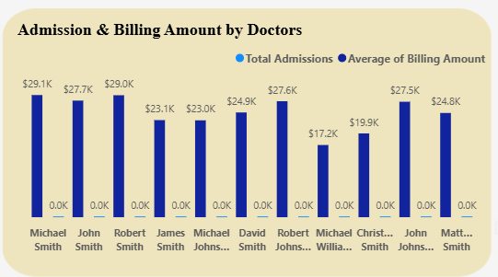
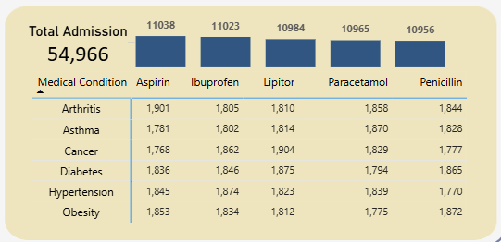
Analysis and visualization
This chart shows Total Admissions and Average Billing Amount per Doctor.
Top performance include:
. Michael Smith - $29.1k billing
. Robert Smith -$29.0k
. John Smith -$27.7k
. David Smith – 27.6k
. Matt Smith -$24.8k
This matrix cross-references medications and medical conditions based on total admissions:
Total Admissions per medications:
Aspirin: 11,038, Ibuprofen: 11,023, Lipitor: 10,965, Paracetamol: 10,965 and Penicillin: 10,956
Medication usage by condition:
Arthritis: Aspirin (1,901), Asthma: Ibuprofen (1,828), Cancer: paracetamol (1,904), Obesity: Penicillin (1,872)etc.

Slide 14
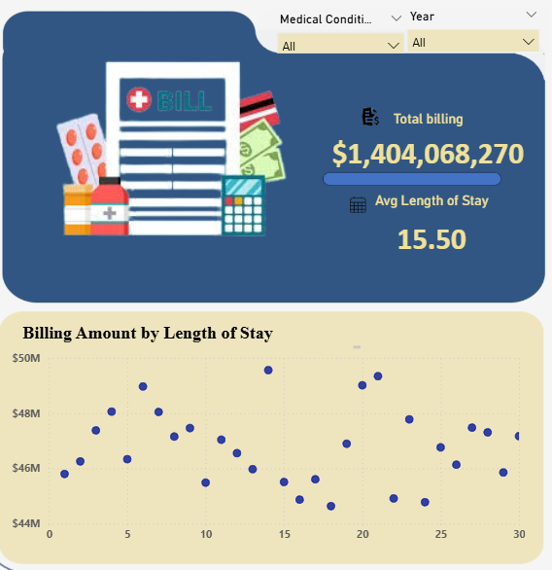
Analysis and visualization
Total Billing Amount: $1,404,068,270
Average Length of Stay: 15.5 days
Billing Amount by Length of Stay (Bottom left Scatter Plot)
This scatter plot maps the length of hospital stay (days) against the total billing amount.
Most data points cluster between 3-15 days with billing ranging between $44m to $50m.

Slide 15
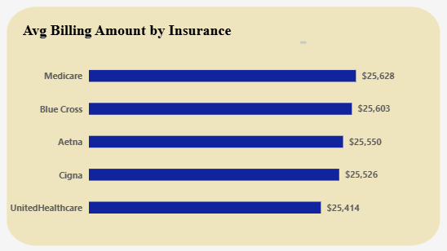
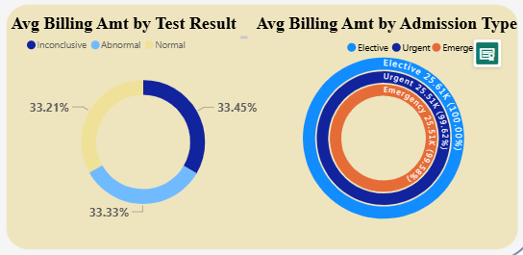
Analysis and visualization
This bar chart shows how much, on average , is billed per patients under each insurance provider:
. Medicare: $25,628
. Blue Cross: $25,603
. Aetna: $25,550
. Cigna: $25,526
. United Healthcare: $25,414
The first Donut Chart shows the Average Billing by Test Result
The average billing is fairly even distributed among test result categories: Normal: 33.45%, Inconclusive: 33.33%, Abnormal: 33.21%
The second multiple donut chart shows the billing Amount by Admission Type
. This chart shows:
. Elective Admissions: $25.5k (40.00%), Urgent Admissions: $25.3k (30.67%)
. Emergency Admissions: $25.1k (29.33%)

Slide 16
Recommendation
1. Improve Care for Elderly Patients: The “Old” age group accounts for the highest number of admissions (24.32K). Train staff in elderly care to handle complex, multiple conditions and include home-based care options.
2. Chronic Disease Prevention Programs through Launching awareness campaigns, free screenings, and lifestyle interventions. This is to reduce the number of chronic diseases among individuals.
3. Maintain fair and consistent billing practices as Elective admissions have the highest average billing ($25.5K), compared to urgent ($25.3K) and emergency ($25.1K).
4. Address Seasonal Peaks in Admission and Stay by Increase staffing and resource allocation during high-demand months. Monitor seasonal illness trends for early preparedness to prevent overcrowding and maintain service quality year-round.
5. The male has the highest number regrading insurance, Offer gender-sensitive care pathways (e.g., maternity, men’s health).
Launching awareness campaigns on how they can take good care of there health to reduce the rate at which they fall sick.
6. Ensure efficient drug supply management and cost-effectiveness. Drugs like Aspirin, Ibuprofen, Paracetamol, and Penicillin are heavily used across multiple conditions. Monitor prescription trends to avoid overuse or resistance. Use analytics to inform procurement and inventory.

Slide 17
THANK YOU

